Slide 1
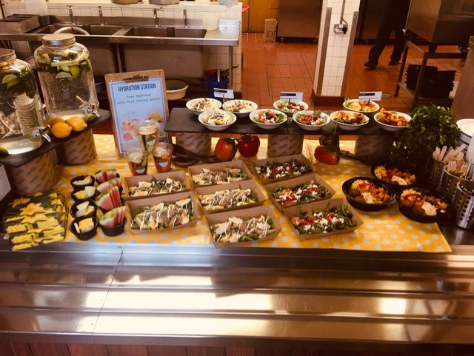
New Salad Bar @St Francis

Slide 2
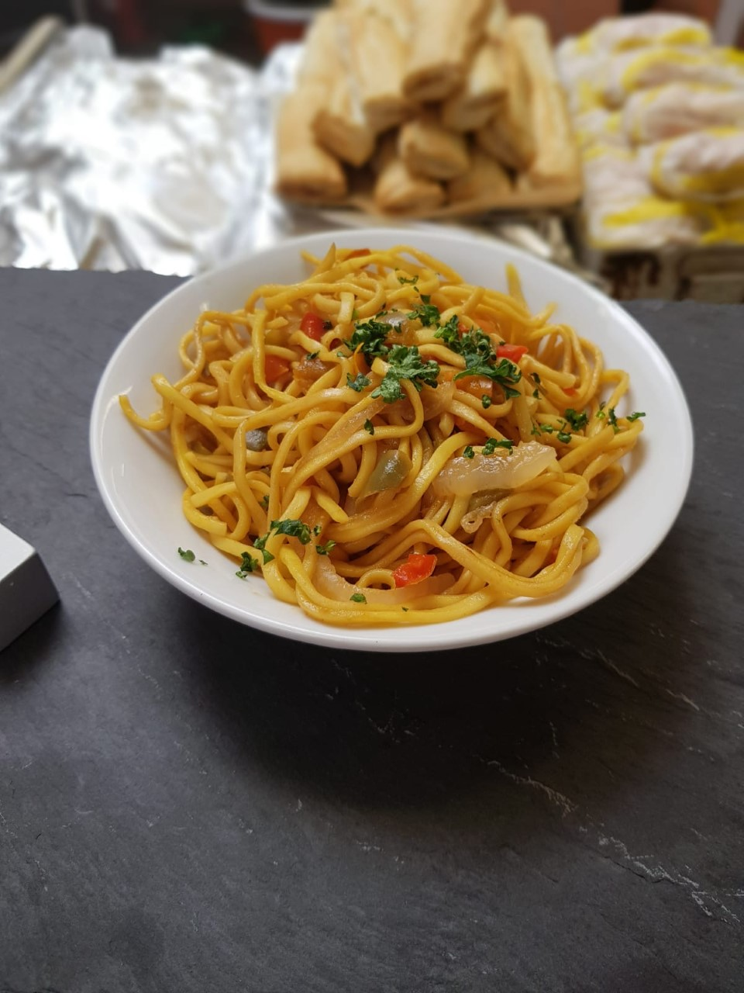
Sweet Chili and Soy Noodles .
Egg Noodles
Peppers (Diced)
Sweet Chili Sauce
Soy Sauce
Chopped Parsley
Cooked Noodles in boiled water.
Drain Noodles using cold water.
Mix in the sweet chili sauce and soy sauce to taste.
Cook off peppers and mix int noodles
Sprinkle Chopped parsley on top.
REMEMBER YOU CAN USE ANY STIR FRY VEGETABLES IN THIS SALAD!

Slide 3
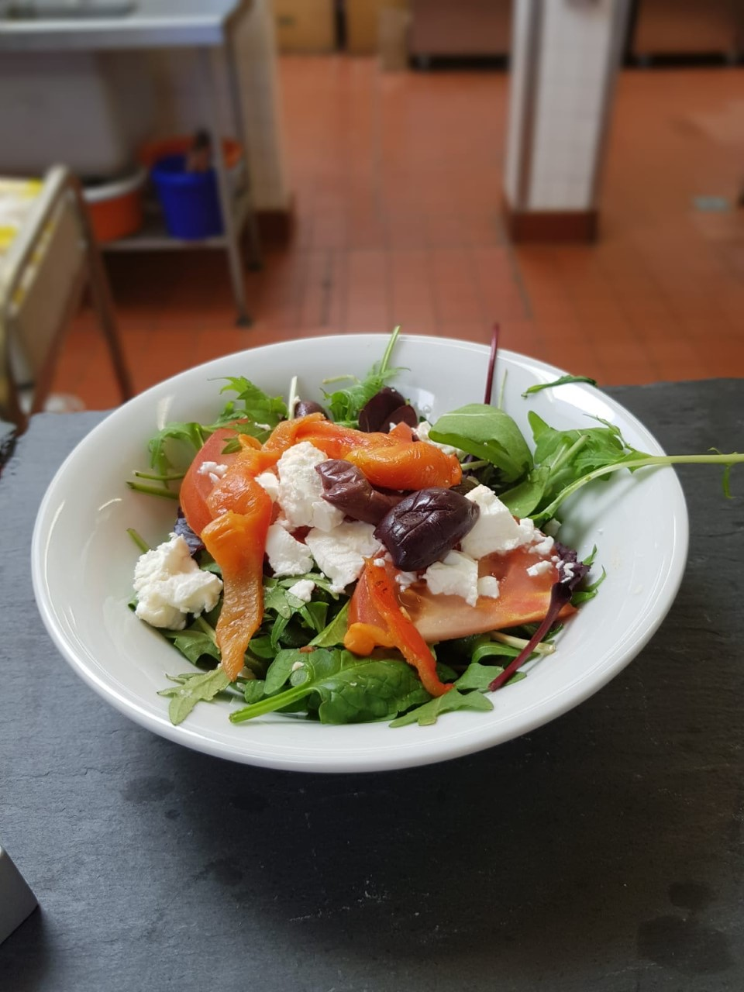
Greek Feta Salad
Feta
Black Olives
Mix Leaf Salad
Tomato
Roasted red peppers
Balsamic Glaze
Wash mixed leaf salad
Chopp roasted red peppers.
Crumble feta
Drizzle glaze.
REMEMBER TO MIX THE ICEBERG WITH THE ROCKET IN THIS SALAD!

Slide 4
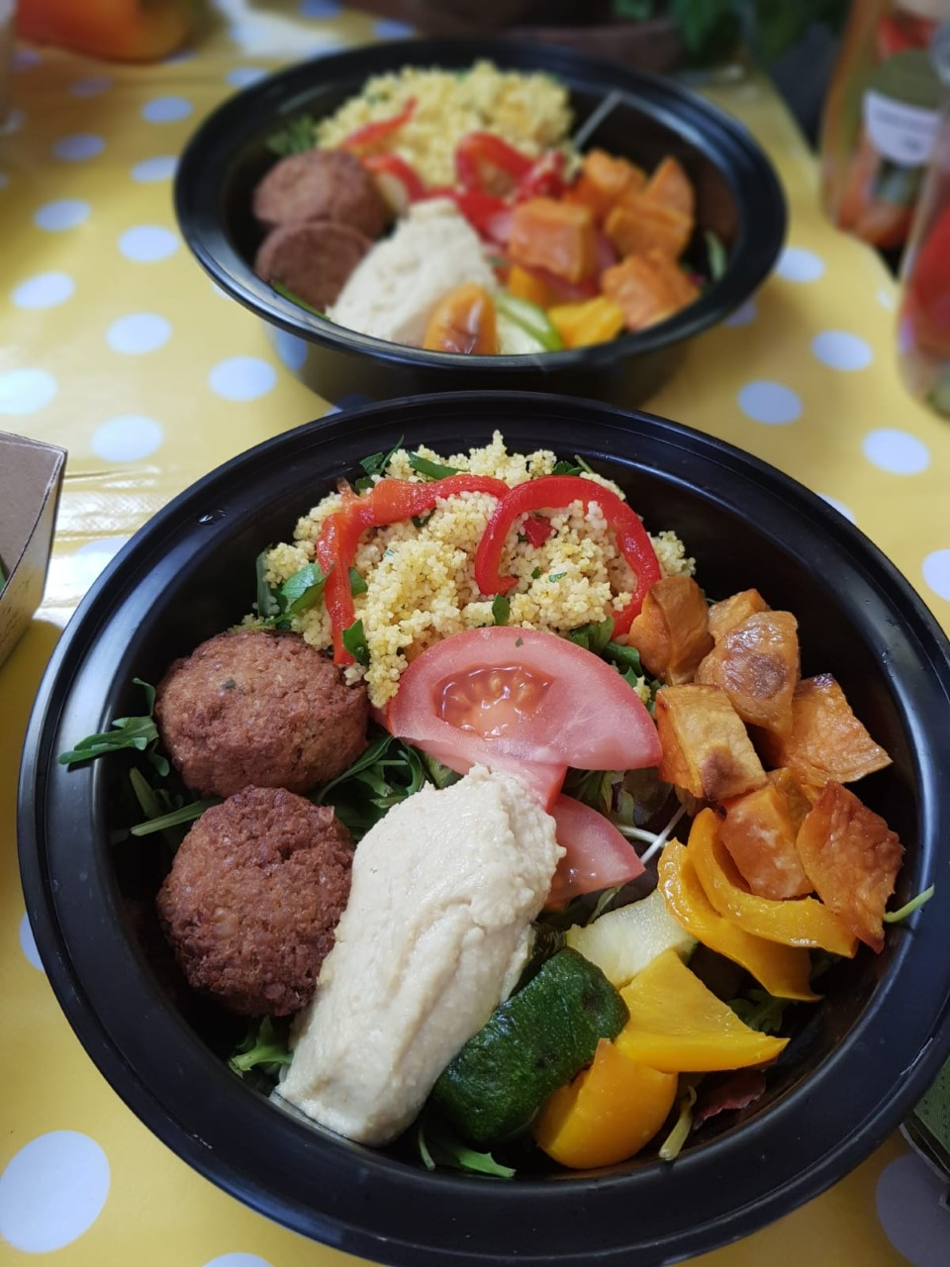
Buddha Bowls
Falafel
Humus
Tomato
Green Beans
Seeds
Roast Vegetables
Mixed Leaves
Couscous
Cook falafel
Chop and Roast Vegetables
Flavor couscous with turmeric and stock.
Arrange in black bowl as shown in picture.
REMEMBER YOU CAN USE ANY RAW INGREDIENTS IN THIS SALAD!

Slide 5
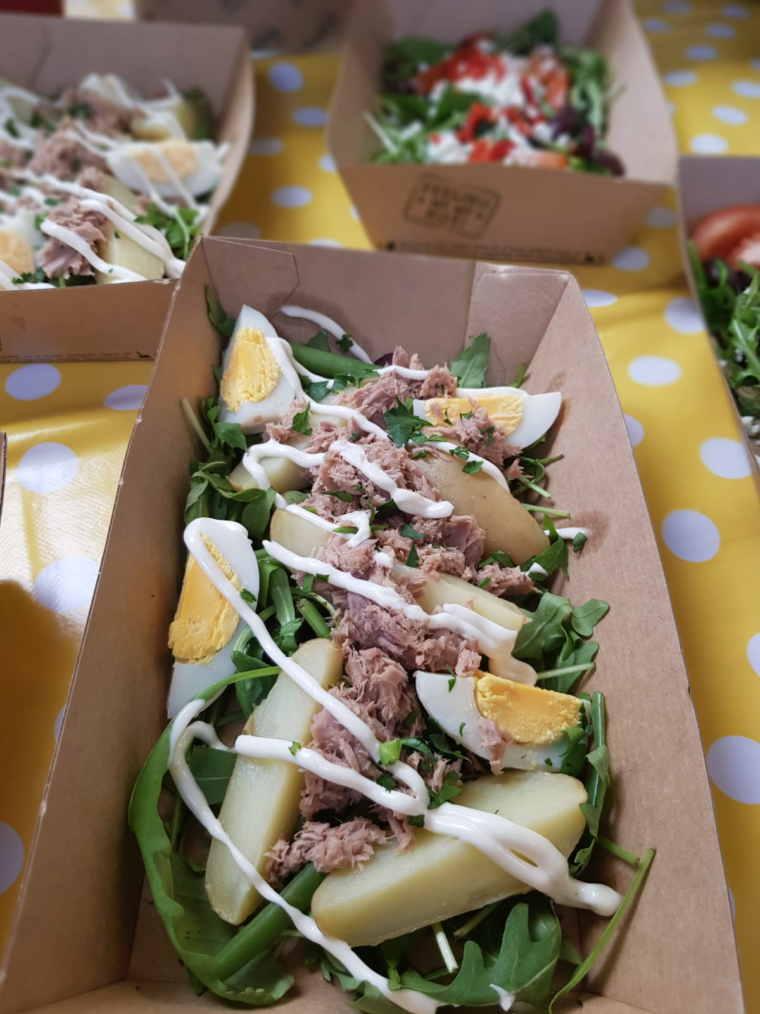
Tuna Nicoise Salad
Tuna
New potato
Boiled Egg
Green Beans
Mixed salad/ice berg
Mayonnaise
Cook – New potato, Egg, Green Beans
Chop cooked potato and egg. Chop iceberg.
Arrange in dish as shown in picture.
Pipe mayonnaise over dish.
REMEMBER TO PIPE THE MAYONAISE IN THIS SALAD!

Slide 6
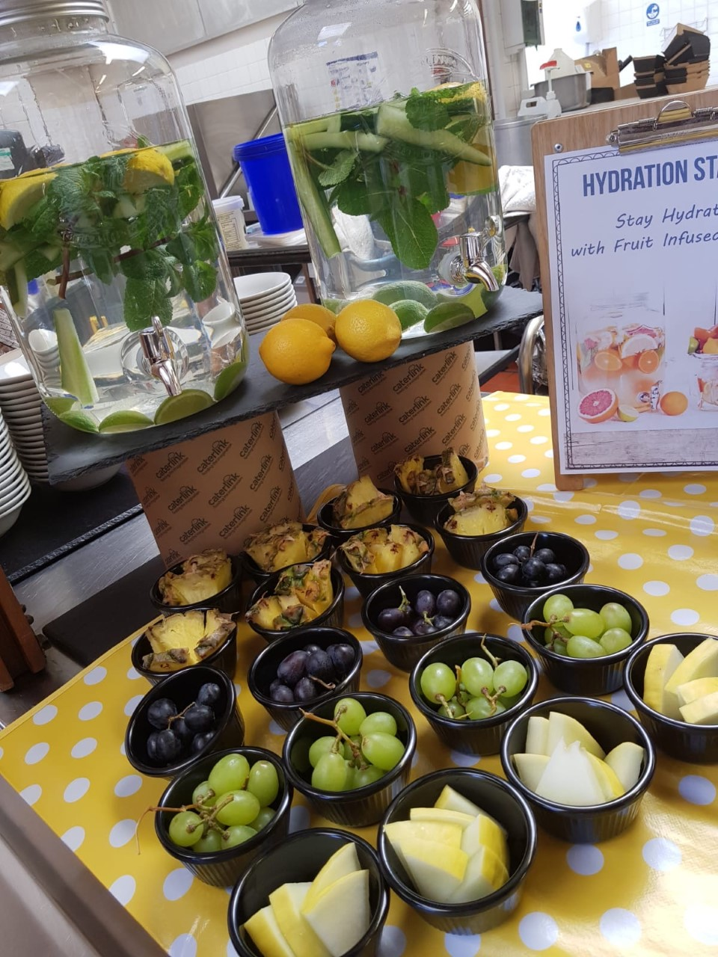
DON’T FORGET THE FRUIT POTS AND HYDRATION STATION TO BE SET UP FOR BOTH BREAK AND LUNCH!

