Slide 1


Catering Review St. Francis of Assis Catholic Technology College – February 2020

Slide 2
Service Review
Review short term mobilisation plan
Standards
New products – New Spring Salad bowls
New Look for Spring 2020
Marketing – India destination day
Equipment and clearing station
War on Waste – Reduce disposables
Safeguarding/ Training
Loyalty Cards for war on waste

Slide 3
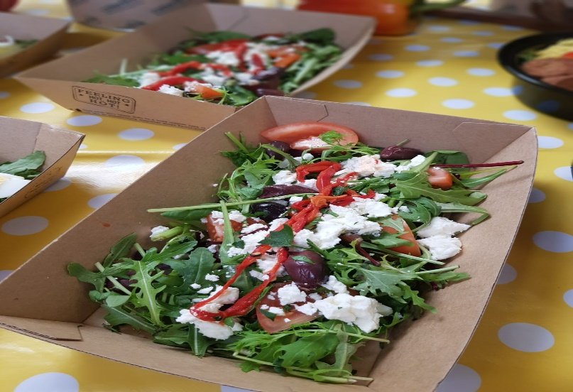
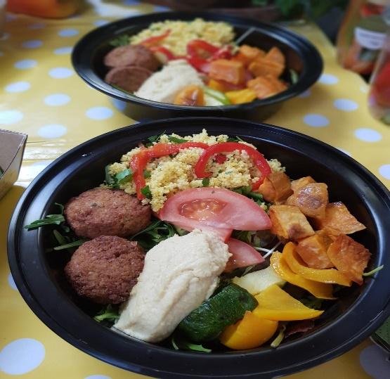
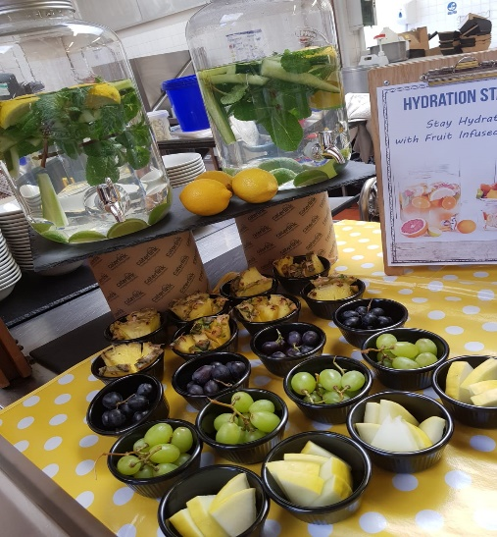
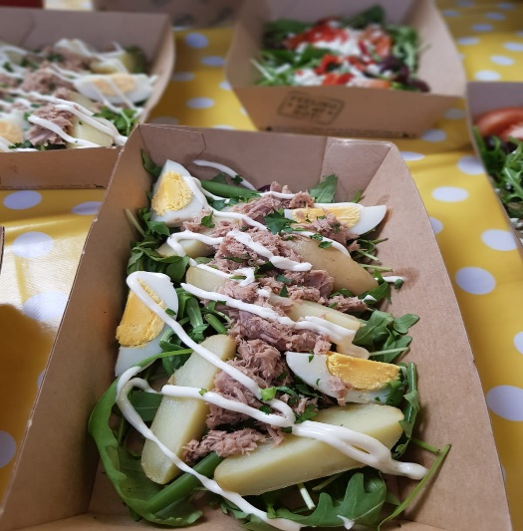
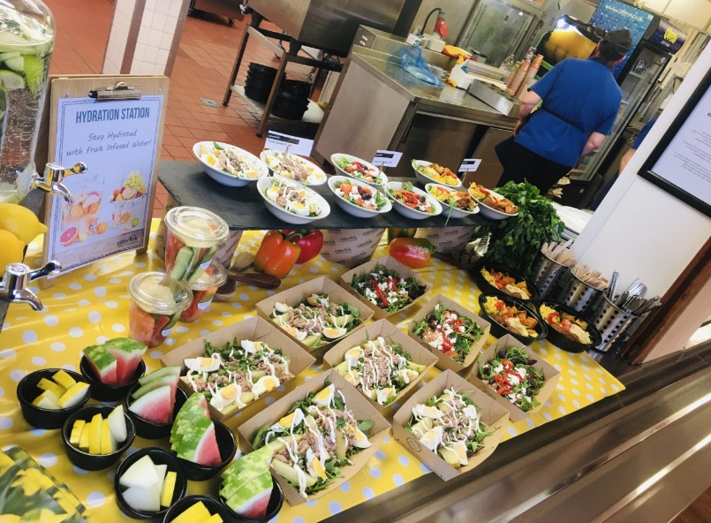
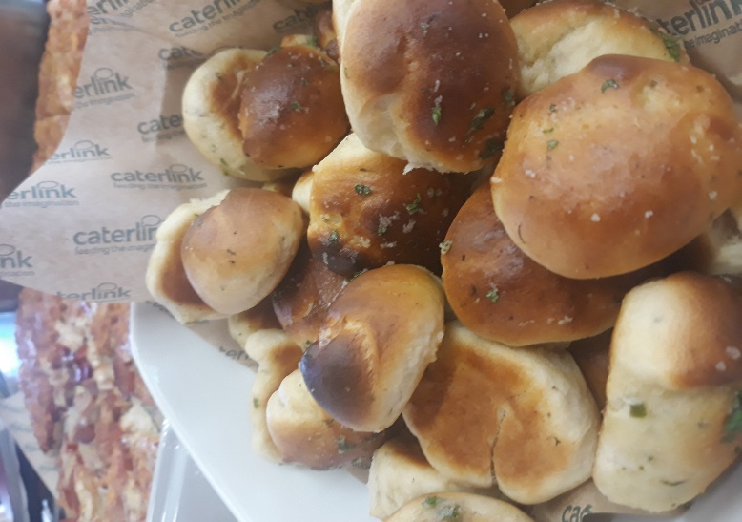
New Spring Salad bowls
Simon and his team have been supported by Alona and Luke in the last few weeks and have now started to introduce new products which offer the students and staff more healthier choices.
The first new option has been our new salad bowls and Buda bowls which we are encouraging students to eat in from china bowls but have also offered a reusable plastic bowl and a fully recyclable take away salad dish .
These salads are priced as per a main meal dish with 1 side
These salads are served with sides of homemade dough
balls , washed down with a different flavoured Hydration Station water each day

Slide 4
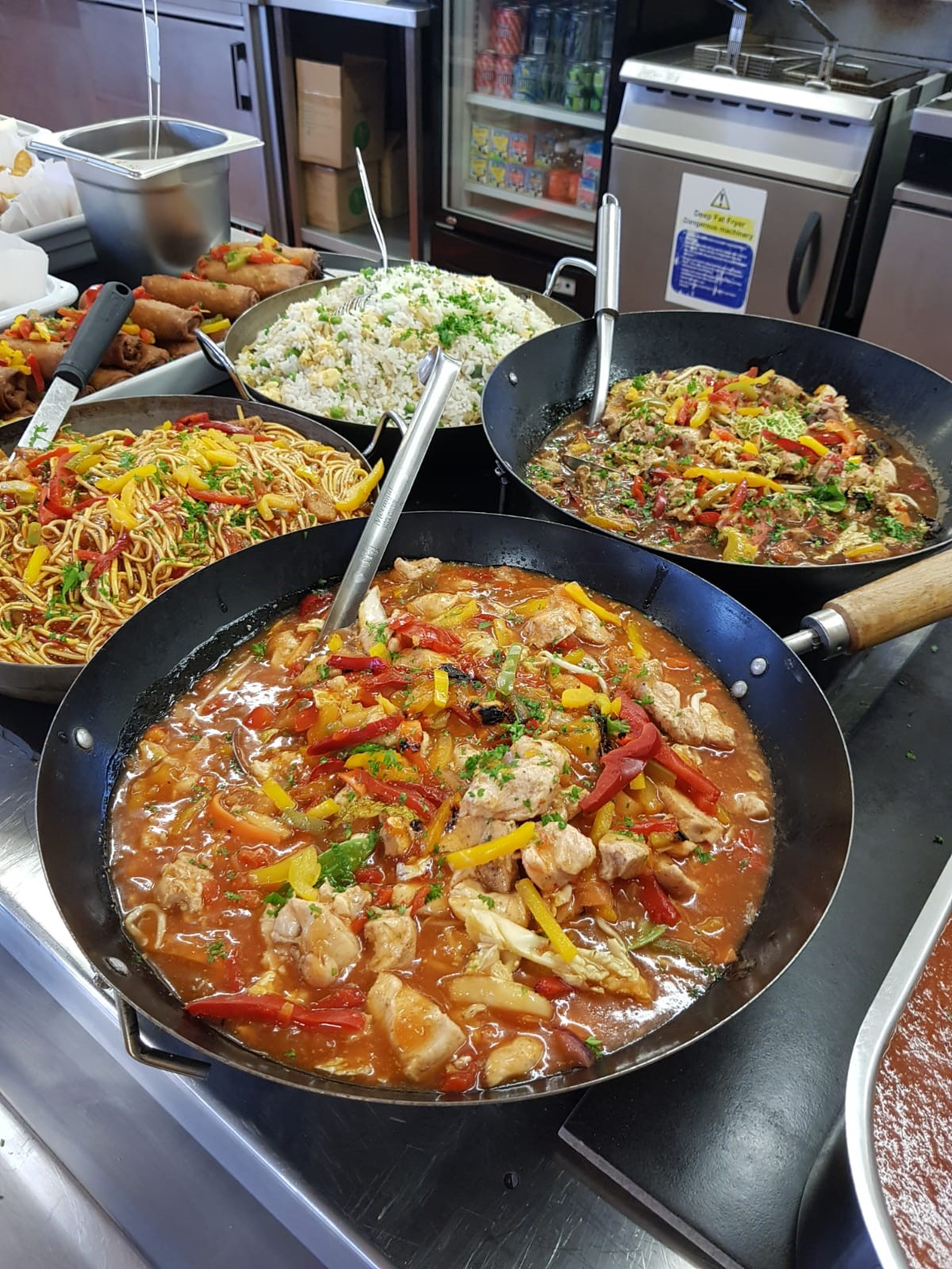
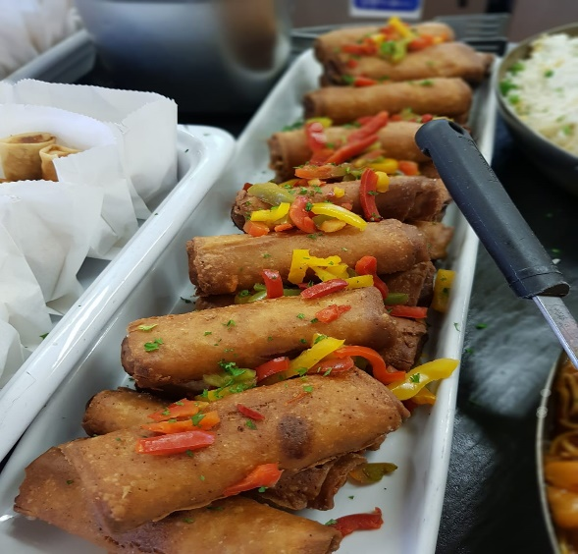
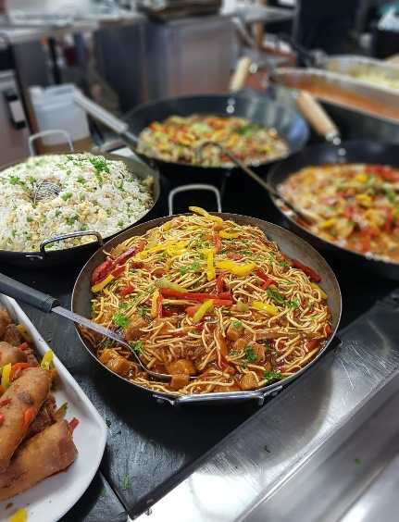

Chinese New Year
This was celebrated in February with Chicken Chow Mein , Vegetables in Black Bean sauce , and lots of noodles !
Chinese Vegetable Pancake rolls were really popular with the students too !
Take away pots were available and we are planning to do the theme days in the other outlets going forward

Slide 5




Shrove Tuesday
We made 300 pancakes on Pancake day and served with a variety of toppings , several students tried the new salads with one side and a pancake dessert with topping for their main meal deal lunch .
The new fruit pots in reusable dishes were also a great hit

Slide 6
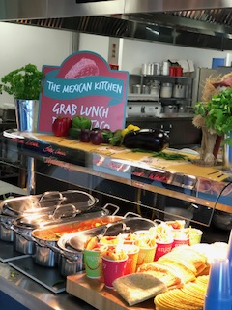

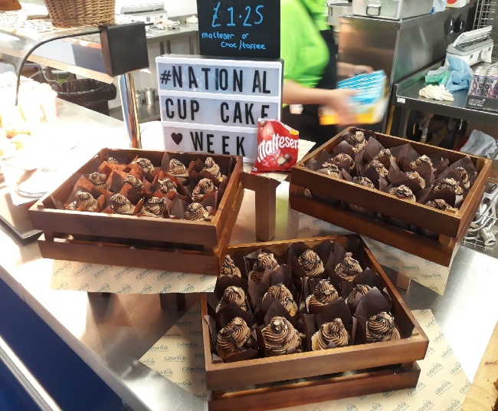


New look for Spring 2020
We have purchased some bright yellow aprons for the serving staff to wear this is just a stop gap until we decide with the college on a complete new uniform .
Some new service dishes have been purchased and we have brought new counter equipment to improve the look of the food on the server .
During March we will be giving the outlets all a new look and product offer too !

Slide 7
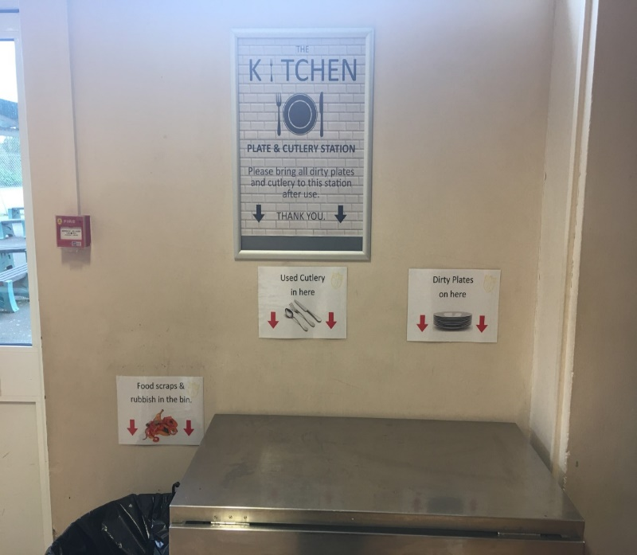
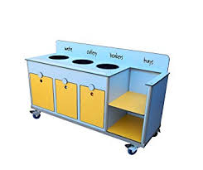
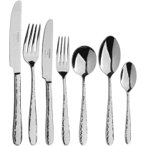
War on Waste
One of our key objectives is greatly reduce the use of disposable in the dining hall and all of the outlets.
This month we have brought back the proper cutlery and plates
We have ordered new totally recyclable sandwich boxes and salad boxes
We have introduced a new clearing area again this will be a full recycling unit when we have discussed the future spend of the investment and we will need to buy a new clearing trolley.
We have trained the staff on out “ War on Waste guide “

Slide 8
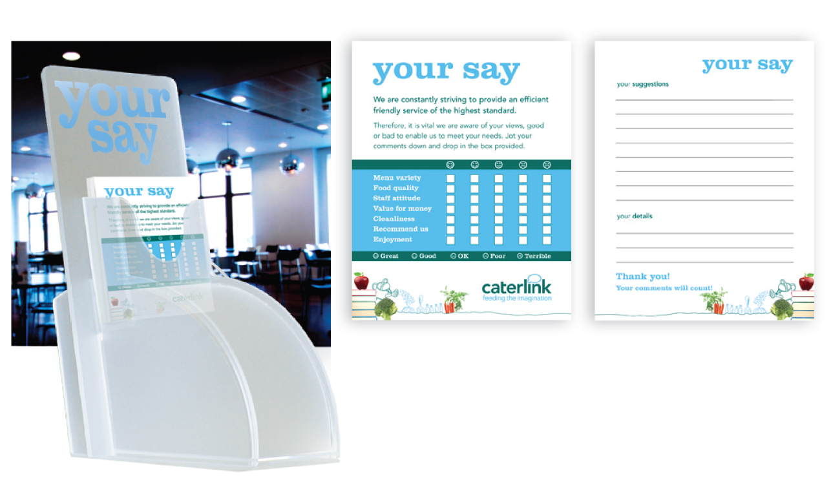
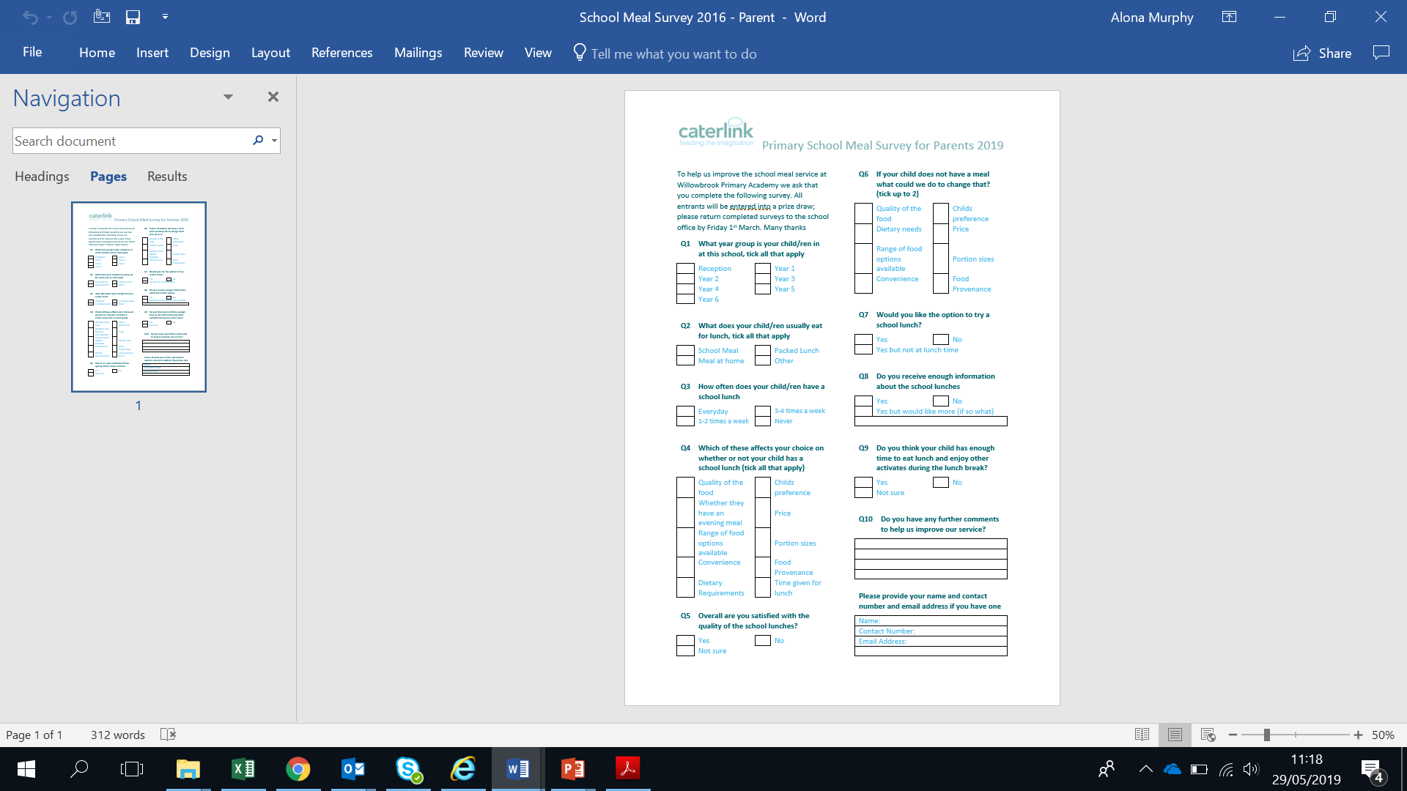
Customer comment cards or Survey?
We have completed a low key survey with the students and have used this feedback in our relaunch plans .

